Slide 1

A Quantitative Strategy for Time-to-event Analysis with Composite Endpoints
Yixiao Tang | Hein Putter | Jan Lindeman
Notes:
Thanks, Hein! It was a nice introduction! I appreciate it! Please allow me to say a brief thank you to all my friends for being here to support me through this important moment. Thank you!
Alright! Let’s get started! Let’s see what I‘ve done for my master’s thesis! My thesis began with an amazing idea from Jan, and I will tell you the amazing idea shortly. Jan works in the Vascular department at LUMC, and he has found a significant limitation in using composite endpoints for time-to-event analysis in the cardiovascular domain. Therefore, we hereby create a new method, a quantitative strategy for time-to-event analysis with composite endpoints.

Slide 2
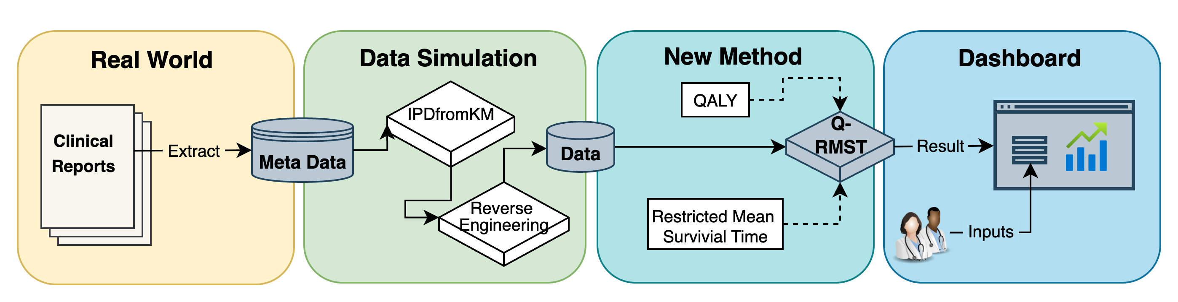
Project Pipeline
Motivation
Data Simulation
Methods
Result
Discussion

Slide 3

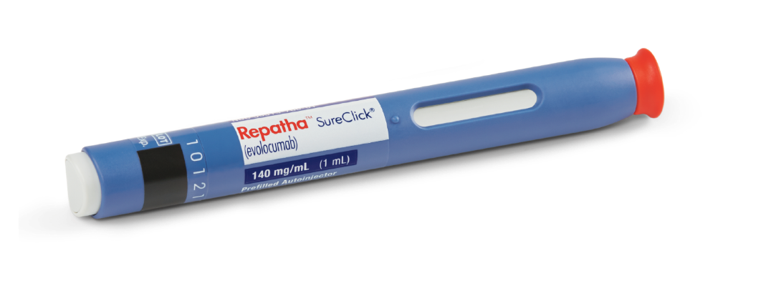

Decision Making
4S Trial:
30% significant reduction in cardiovascular death
FOURIER Trial:
15% significant reduction in major cardiovascular events
Motivation
Data Simulation
Methods
Result
Discussion
Notes:
Time-to-event analysis may be a new term for most of you, and the most commonly used methods are the Kaplan-Meier estimator and the Cox proportional hazard model. Here, we don’t have to understand how it works, but I’d like to show you the results of two relevant Clinical trials according to my research. The first Trial, named 4S, which was conducted in Scandinavia a long time ago, and that trial aimed to test the efficacy of the treatment: Simvastatin. And the second Trial, named FOURIER, which was conducted recently, aimed to test the efficacy of the new treatment Evolocumab.
We could first look at the visualized Kaplan-Meier curves, which give us an intuition, both treatment groups for the two trials behave better than the placebo group, because both red lines are below the black lines, which means the probability of failure is consistently lower in the treatment groups over time.
And the Cox regression model gave us the quantitative estimations of how much better the treatment groups behaved. For the 4S trial, there is a 30% reduction in cardiovascular death, and for the FOURIER trial is a 15% reduction in major cardiovascular events (including death). So, if you are sensitive enough, I think you are probably thinking, how can you compare these two results based on different populations and different clinical endpoints? Yes, exactly, this is the challenge, the research question we worked with!

Slide 4
Outline
Chapter 1: Motivation
Chapter 2: Data Simulation
Chapter 3: Q-RMST Method
Chapter 4: Results
Chapter 5: Discussion
Motivation
Data Simulation
Methods
Result
Discussion
Notes:
Let me tell you how we did it through 5 parts: motivation, data simulation, the key method we developed, named Q-RMST, then results, and the discussion.

Slide 5
Motivation: FOURIER Trial
Composite Endpoints:
Cardiovascular death;
Myocardial Infarction;
Coronary Revascularization;
Stroke;
Hospitalization for Unstable Angina.
Take the first event that happens to the patient
Motivation
Data Simulation
Methods
Result
Discussion
4
Notes:
Let’s unpack the FOURIER Trial I mentioned before a bit further to see what kind of cardiovascular events they used as the composite endpoints. It covers cardiovascular death, myocardial infarction, coronary revascularization, stroke, and hospitalized angina. By definition, we count whichever of these happens first for each patient.

Slide 6
Motivation: FOURIER Trial
Method:
Cox proportional hazard regression
Result:
Hazard Ratio (95%CI): 0.85 (0.79-0.92);
Significant level: p < 0.001.
Conclusion:
15% significant reduction
in major cardiovascular events
Motivation
Data Simulation
Methods
Result
Discussion
5
Notes:
And based on these composite endpoints, their researchers used a Cox regression model and gave the conclusion of a 15% significant reduction in major cardiovascular events to provide the essential support for the drug's launch and marketing.

Slide 7
Limitations
No consideration of the different clinical importance
Different types of events mean different to the patient (e.g., Death vs. Revascularization)
Ignorance of subsequent events
- Later events not captured in the analysis
Relative Risk Estimation
- Lack of direct clinical interpretability and comparability
How do we interpret a 15% reduction?
Motivation
Data Simulation
Methods
Result
Discussion
Notes:
If you are sensitive enough, as I am, as we are. You will probably agree with the limitations they have. First, they ignored the different clinical importance of the 5 types of events; death, of course, is way worse than revascularization, there is no doubt. Second, they ignored the follow-up events after the first one; as long as the patients haven’t died, you should respect the later events that happen to them; they are also important! Third, the result of the Cox model is a risk estimation that is not comparable across different studies and is less understandable for the patient. So now I think the interpretation of the 15% reduction conclusion is debatable, and could be better.

Slide 8
Criticism of FOURIER Trial
Composite endpoints are unequivalent
The subsequent events are important
Motivation
Data Simulation
Methods
Result
Discussion
Notes:
In order to make it better, there are two main criticisms we want to work on: the unequivalent composite endpoints and important subsequent events.

Slide 9
Idea & Aim
Composite endpoints are unequivalent -> QALY
The subsequent events are important -> Multi-state Model
Final aim:
Integrate QALY utility
into Restricted Mean Survival Time
with Considering all Subsequent events
Motivation
Data Simulation
Methods
Result
Discussion
Notes:
And the idea for composite endpoints is QALY utility. I will explain that to you shortly, and the idea for subsequent events is the Multi-state Model. The final aim of our research is to integrate QALY utility into Restricted Mean Survival Time with considering all subsequent events.

Slide 10


Data Simulation
Original Data
Clinical Study Report
- Kaplan Meier Curves (and numbers) of each type of event (not necessarily as the first event)
- Numbers of the first events of each type
- Numbers of patients with 0, 1, 2, 3+ events
Motivation
Data Simulation
Methods
Result
Discussion
Notes:
Unfortunately, there was another side challenge about the unavailable original data, which we need to illustrate the new method we developed. So here we come to the idea of data simulation, to simulate a most possible data according to the published clinical report, which contains 3 key information of Kaplan-Meier curves and numbers of each type of events, the numbers of the first event, and the numbers of patients who had 0, 1, 2 or more than 3 events.

Slide 11
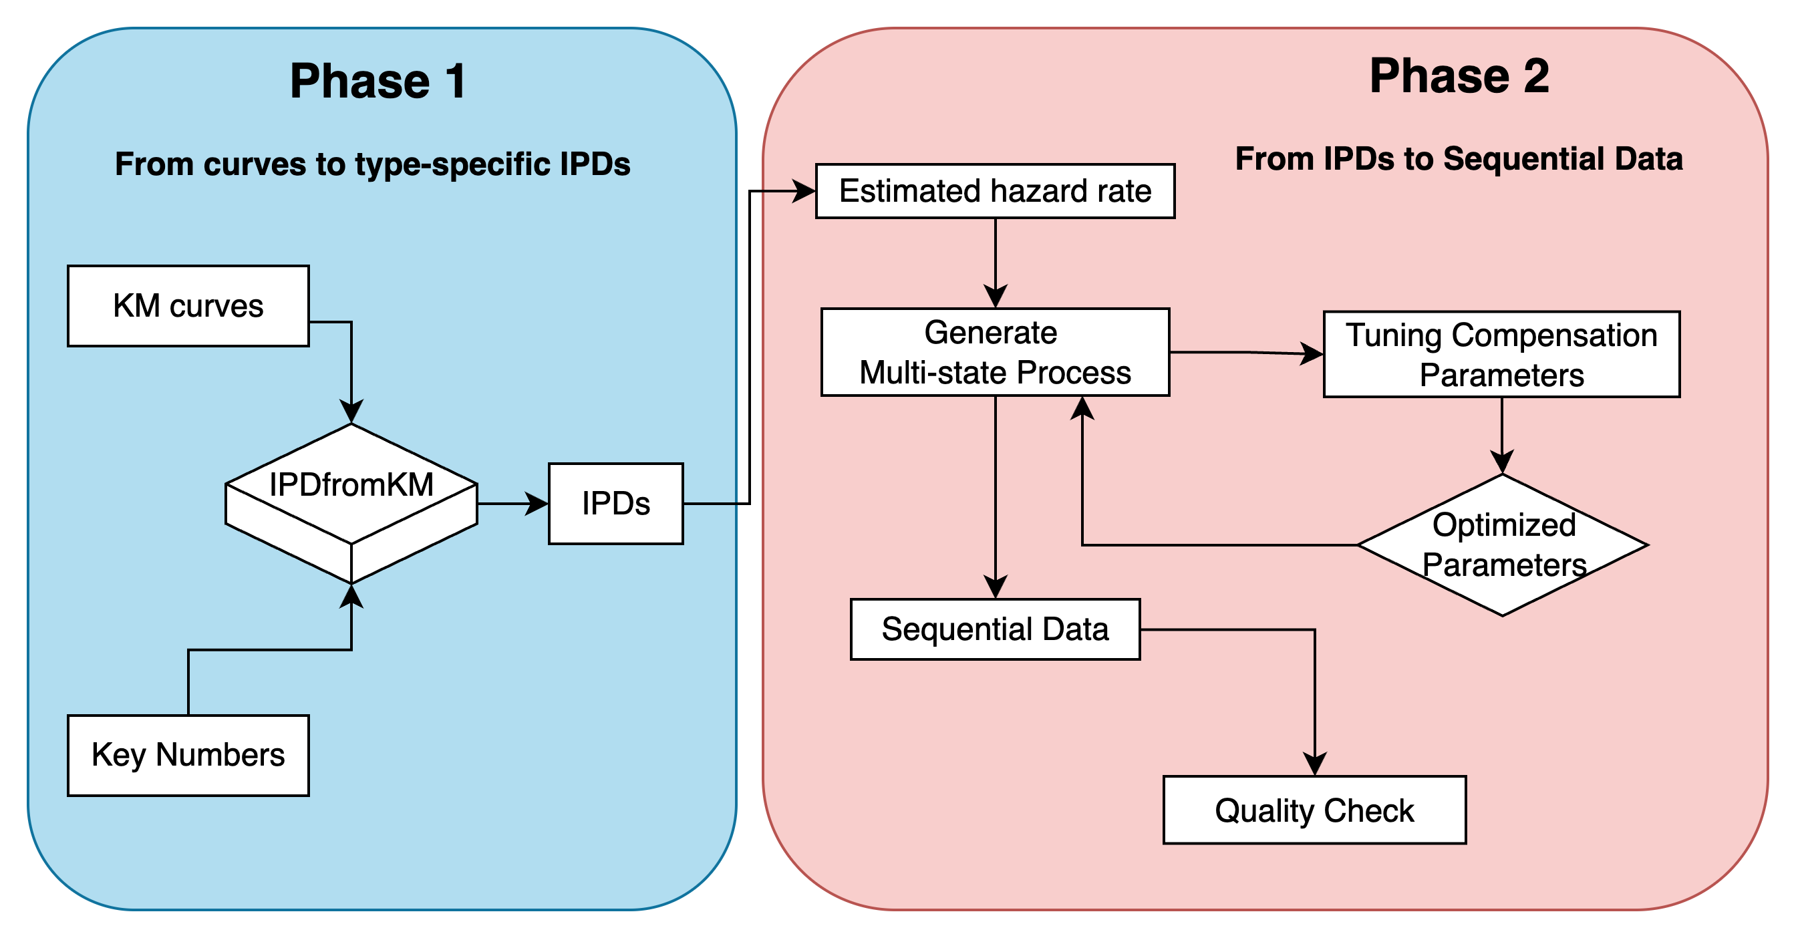
Data Simulation
Motivation
Data Simulation
Methods
Result
Discussion
Notes:
There are two phases to proceed data simulation, phase 1 is about reconstructing data from the Kaplan-Meier curves to type-specific individual-level patient data; and phase 2 is about merging and reversing the sequential data from the type-specific IPD, IPD is short for individual patient data.

Slide 12
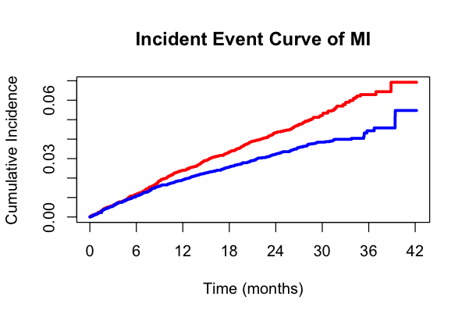
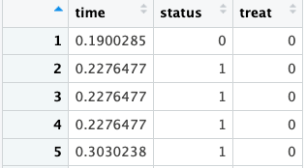


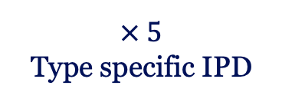
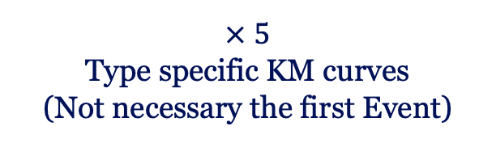
Phase 1 : from KM curves to IPDs
KM: Kaplan-Meier survival curve
IPD: Individual Patient Data
INPUT
OUTPUT
R package:
IPDfromKM
$× 5$
Type specific KM curves
(Not necessary the first Event)
$× 5$
Type specific IPD
Motivation
Data Simulation
Methods
Result
Discussion
Notes:
For phase 1, we used an existing R package: IPDfromKM, reconstructed 5 IPD tables from 5 type-specific Kaplan-Meier Curves. To do this, we used an online tool to digitize the data points as one of the inputs and also provided the key numbers of the survival curves, such as the number of patients at risk at 6 time points and the total number of events during the follow-up time. This process gave us 5 tables containing the event and censoring time for both treatment arms.

Slide 13
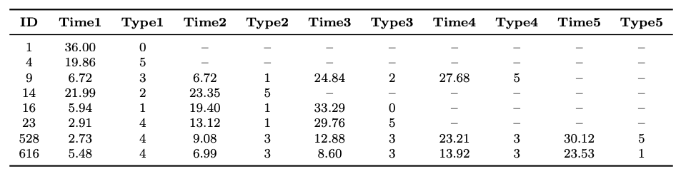




Phase 2 : from IPDs to Sequential Data
IPD: Individual Patient Data
INPUT
$× 5$
Type-specific IPD
OUTPUT
Algorithms:
Reverse Engineering
$× 1$
Sequential IPD
Motivation
Data Simulation
Methods
Result
Discussion
Notes:
For Phase 2, we took the end product of Phase 1 as the input, and created a reverse engineering algorithm that aims to merge and reverse 5 type-specific IPD tables into one sequential IPD that has all the subsequent events.

Slide 14
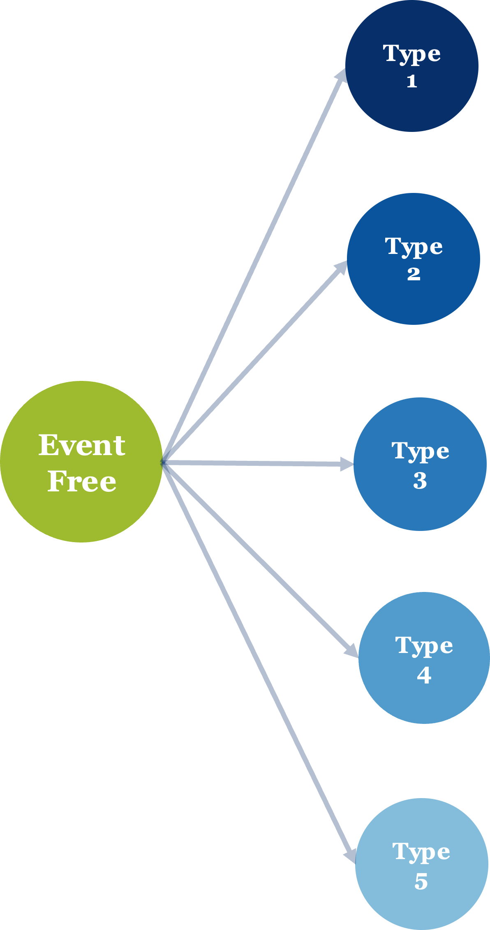
Type 1
Type 2
Reverse Engineering: Aim
Terminal Event (e.g. death)
Event Free
Type 3
Non-terminal Event
(e.g. revascularization, stroke)
Type 4
Type 5
Data Simulation
Motivation
Data Simulation
Methods
Result
Discussion
Notes:
Let me visualize the purpose of reverse engineering to you, so firstly, we had the time-to-event information of the 5 types of events, which is not necessarily the first one, so it is an overall event information during the entire follow-up time. Here, each circle represents one type of event, the darkest blue is the terminal event, death, and the rest of them are non-terminal events; the green one is their starting point: the event-free state.

Slide 15
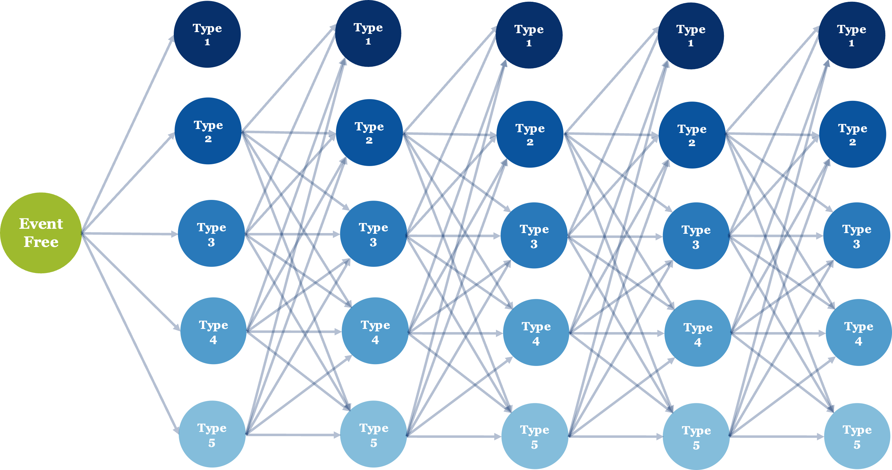
Type 1
Type 1
Type 1
Type 1
Type 1
Type 2
Type 2
Type 2
Type 2
Type 2
Event Free
Type 3
Type 3
Type 3
Type 3
Type 3
Type 4
Type 4
Type 4
Type 4
Type 4
Type 5
Type 5
Type 5
Type 5
Type 5
Reverse Engineering: Aim
Terminal Event
(e.g. death)
Non-terminal Event
(e.g. revascularization)
Motivation
Data Simulation
Methods
Result
Discussion
Notes:
Based on that, we want to reverse a more detailed scenario from the overall one, more detailed means the history or trajectory of events for each patient. As long as patients haven’t reached the terminal event, they still have a chance to experience other events. This diagram shows the possible paths a patient might go through. And of course, it is also possible that no events happen to them during the entire follow-up time.

Slide 16
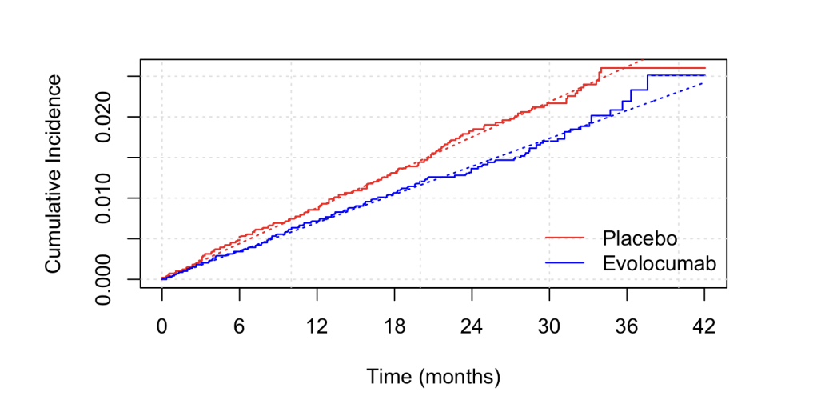
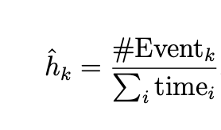


Reverse Engineering: Starting Point
Step 1. Estimate type-specific hazard rates $h_{k}$for each arm
Event type $k=stroke$is on display, actually we have 5 IPDs and 5 plots
Estimate constant hazard of event Stroke
$× 5$
$× 5$
Motivation
Data Simulation
Methods
Result
Discussion
Notes:
Now that we are all clear about the purpose, let’s see how to do that. The first step is to estimate type-specific hazard rates h_k for each arm. Hazard means the instant failure rate; k is the index of a certain type of event. And we estimated that by dividing the total number of events by the sum of the time that all patients were followed. We assume the hazard remains constant over time. By this plot, we can see the constant hazard line is quite close to the survival curve, which means it is a reasonable assumption for this trial.

Slide 17
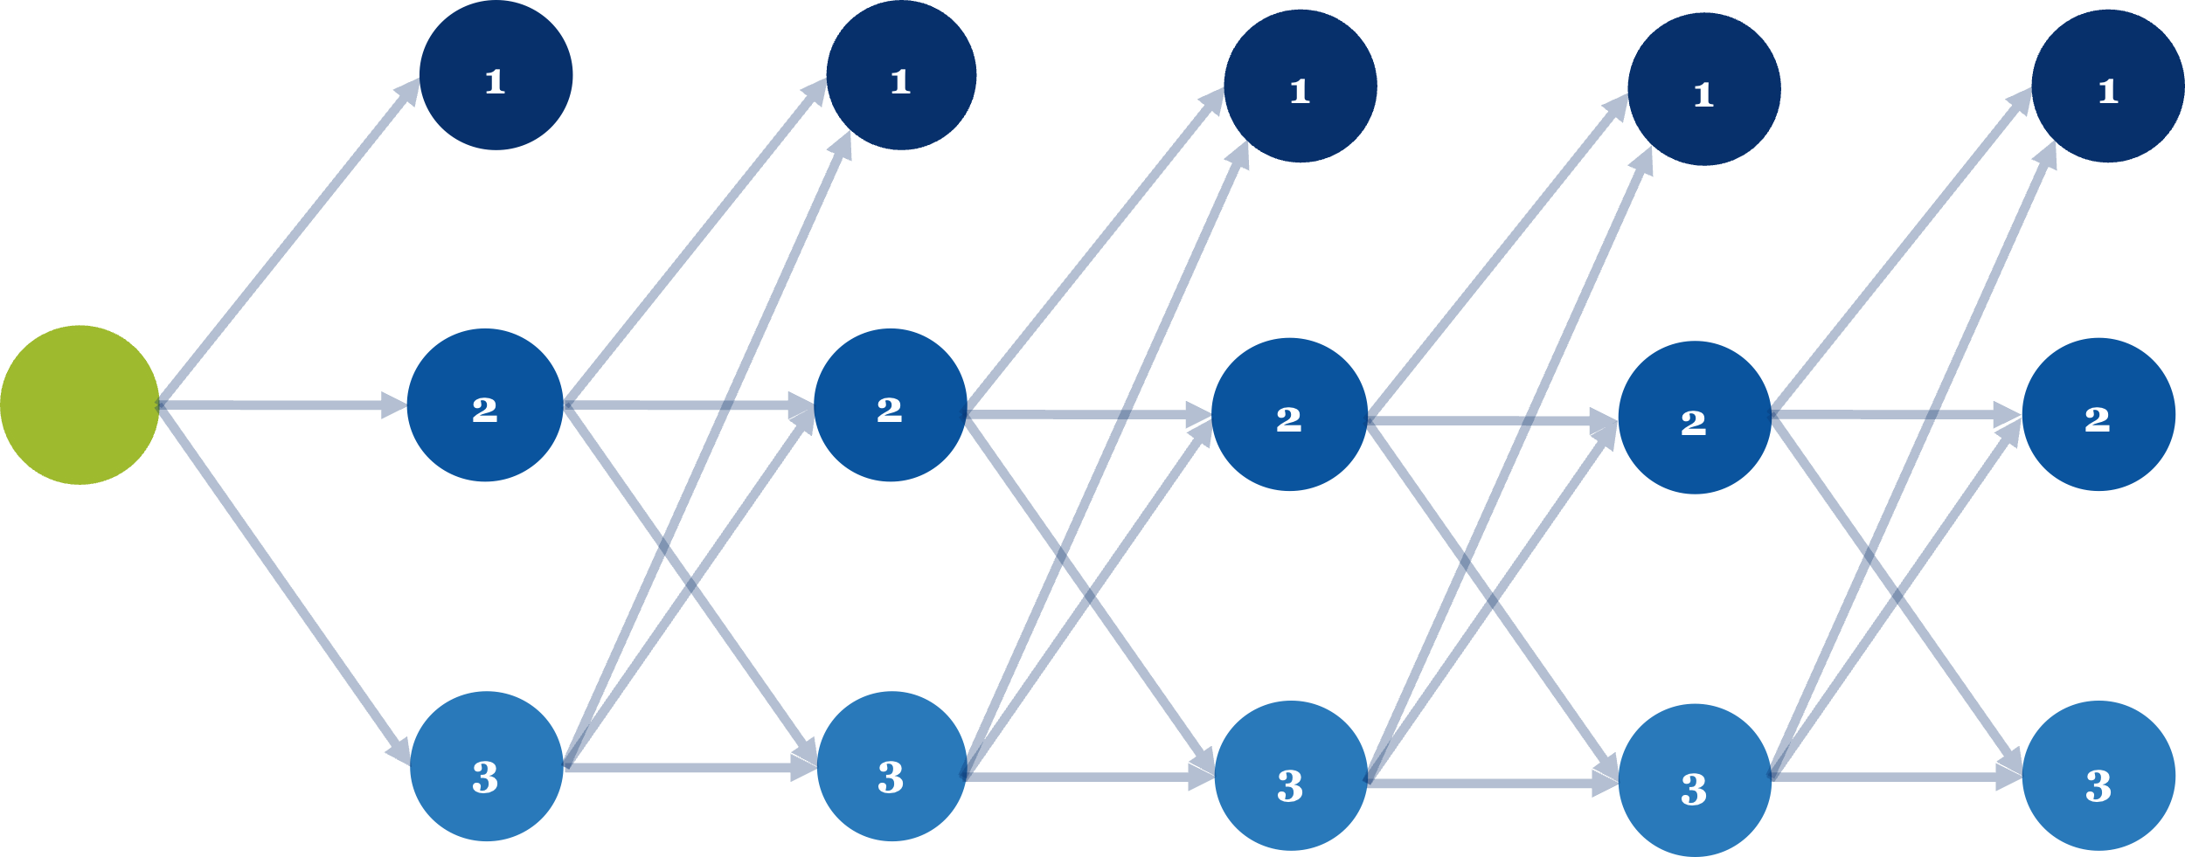
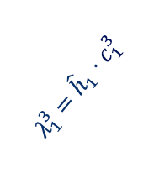
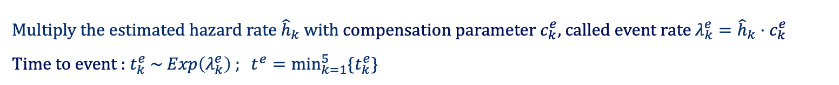
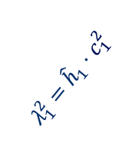
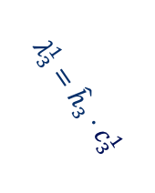
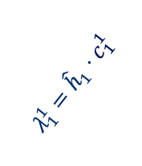
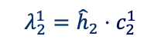
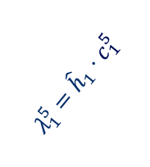
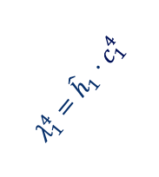
1
1
1
1
1
2
2
2
2
2
3
3
3
3
3
Reverse Engineering: Main Step
Step 2. Generate a sequential process
Multiply the estimated hazard rate ${\hat{h}}_{k}$ with compensation parameter $c_{k}^{e}$, called event rate $λ_{k}^{e}={\hat{h}}_{k}⋅c_{k}^{e}$
Time to event : $t_{k}^{e} \sim Exp\left(λ_{k}^{e}\right) ; t^{e}=\min_{k=1}^{5}{\{t_{k}^{e}\}}$
$$λ_{1}^{1}={\hat{h}}_{1}⋅c_{1}^{1}$$
$$λ_{1}^{2}={\hat{h}}_{1}⋅c_{1}^{2}$$
$$λ_{1}^{3}={\hat{h}}_{1}⋅c_{1}^{3}$$
$$λ_{1}^{4}={\hat{h}}_{1}⋅c_{1}^{4}$$
$$λ_{1}^{5}={\hat{h}}_{1}⋅c_{1}^{5}$$
$$λ_{2}^{1}={\hat{h}}_{2}⋅c_{2}^{1}$$
$$λ_{3}^{1}={\hat{h}}_{3}⋅c_{3}^{1}$$
…
…
…
…
…
Motivation
Data Simulation
Methods
Result
Discussion
Notes:
After that, we move to the main step of generating a sequential process. So here I want to introduce the essential idea of compensation to you. We have all estimated hazard rates for each type of event for each arm in our hands, let’s call them baseline hazard rates, ok? And those baseline hazard rates were estimated by overall events, not necessarily the first one, so we want to give a small punishment, a compensation on that overall hazard rate to have a new one which only counts for the first event. And the same logic for the rest of the events by adding different compensations to the baseline hazard rates. For instance, the hazard for the second event is supposed to be higher than the first one, because patients are more vulnerable since they had their first event, so they are more likely to die. So now we are all clear about the idea of compensation, ok? Now we multiply the compensation parameter by the baseline hazard as the event rate, and this is the rate of an exponential distribution of the time to the event. Now we sample a specific time for each type of event for each arm from their corresponding exponential distribution, and then we take the shortest one among those 5 as the first event. And for the second event, we first filter dead patients out, and then apply the same rule to the remaining alive patients, and so on. And here we assume the maximum number of events that happen to a patient is 5.

Slide 18
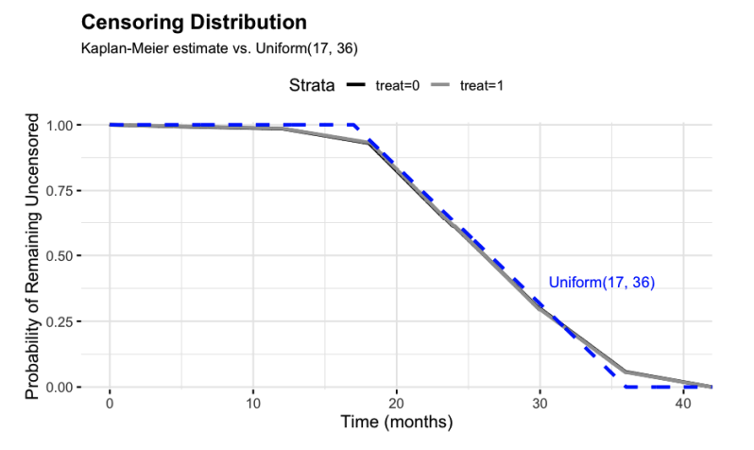
1
1
1
1
1
2
2
2
2
2
3
3
3
3
3
Reverse Engineering: Add Censoring
Step 2. Generate a sequential process
Find the proper censoring distribution: $U(17,36)$
Median follow-up time
Simulation: 26.5 months
Report: 26.4 months
Motivation
Data Simulation
Methods
Result
Discussion
Notes:
To simulate realistic survival data, censoring also needs to be taken care of, because in reality, some of the patients lost follow-up before the end of the trial. So here we found a Uniform distribution with parameters 17 and 36, mimicking the real censoring pattern quite well. In the figure, the blue dashed line is the uniform distribution, and the grey overlayed black line is the censoring distribution from the reconstructed IPDs. Visually, the blue line is quite close, and numerically, the median follow-up time of the uniform distribution is also quite close to the number in the report.

Slide 19
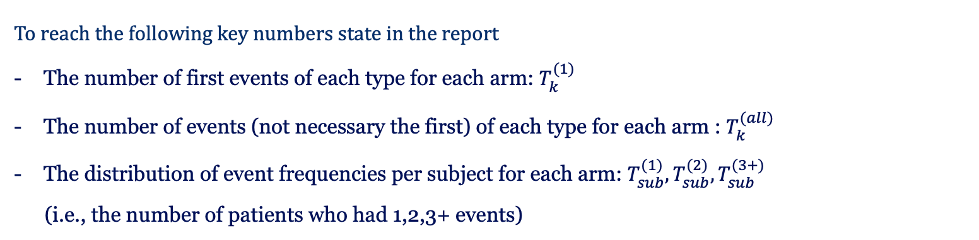
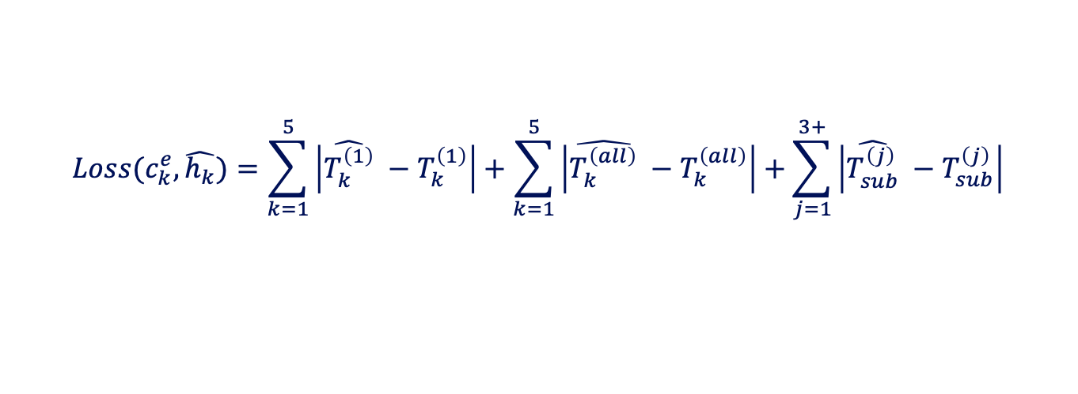
1
1
1
1
1
2
2
2
2
2
3
3
3
3
3
Reverse Engineering: Tune Parameter
Step 3. Optimize Compensation Parameters
To reach the following key numbers state in the report
The number of first events of each type for each arm: $T_{k}^{(1)}$
The number of events (not necessary the first) of each type for each arm : $T_{k}^{(all)}$
The distribution of event frequencies per subject for each arm: $T_{sub}^{(1)},T_{sub}^{(2)},T_{sub}^{(3+)}$
(i.e., the number of patients who had 1,2,3+ events)
$$Loss(c_{k}^{e},\hat{h_{k}})=\sum_{k=1}^{5}{\left|\hat{T_{k}^{\left(1\right)}} −T_{k}^{\left(1\right)}\right|}+\sum_{k=1}^{5}{\left|\hat{T_{k}^{\left(all\right)}} −T_{k}^{\left(all\right)}\right|}+\sum_{j=1}^{3+}{\left|\hat{T_{sub}^{\left(j\right)}} −T_{sub}^{\left(j\right)}\right|}$$
Nelder–Mead simplex method to minimize Loss
Motivation
Data Simulation
Methods
Result
Discussion
Notes:
After adding the censoring distribution, we optimized the compensation parameters to make the simulated data match the key information from the clinical report as closely as possible. To do this, we defined a loss function as the sum of the differences of key information between the simulated data and the original data.

Slide 20
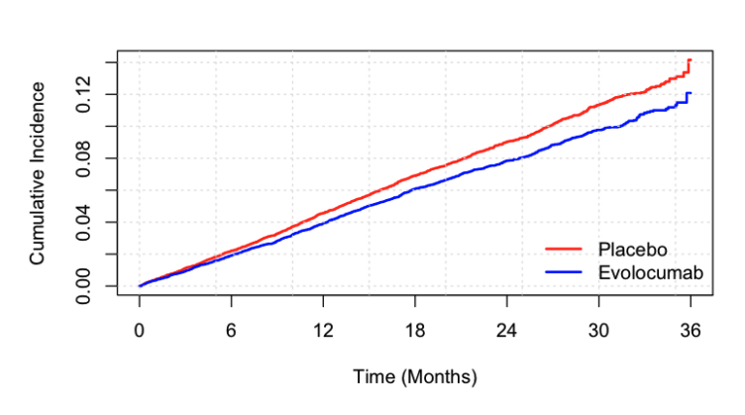
1
1
1
1
1
2
2
2
2
2
3
3
3
3
3
Reverse Engineering: Quality Check
Step 4. Quality Check
Re-fit the Cox Regression Model using simulated data
Composite Endpoints of first event
 | HR | CI | p-value
Simulation | 0.86 | (0.80, 0.93) | <0.001
Report | 0.85 | (0.79, 0.92) | <0.001
Motivation
Data Simulation
Methods
Result
Discussion
Notes:
The final step of reverse engineering is the quality check. We repeated the same analysis as in the original report and obtained a similar hazard ratio, which confirmed that our simulated data is reliable.

Slide 21
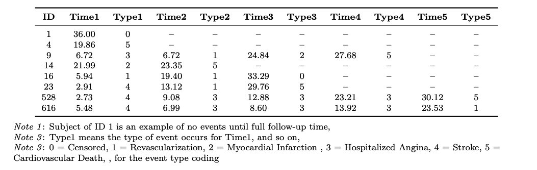
Data Simulation: Result
Motivation
Data Simulation
Methods
Result
Discussion
Notes:
This is the result of Data simulation; a table shows patient ID with their event times and types. Here, I selected several interesting rows of the result, but in fact, the majority of patients are all like ID 1 here; no events happen during the follow-up time.

Slide 22
Q-RMST
Quality Adjusted Life Year
(QALY)
Restricted Mean Survival Time
(RMST)
Motivation
Data Simulation
Methods
Result
Discussion
Notes:
With the simulated data in our hands, now let me officially introduce the Q-RMST method. To break it down a little, Q represents Quality Adjusted Life Year, short with QALY, and RMST is short for Restricted Mean Survival Time. Ok, don’t worry if you still have no idea who they are. Let me show you!

Slide 23
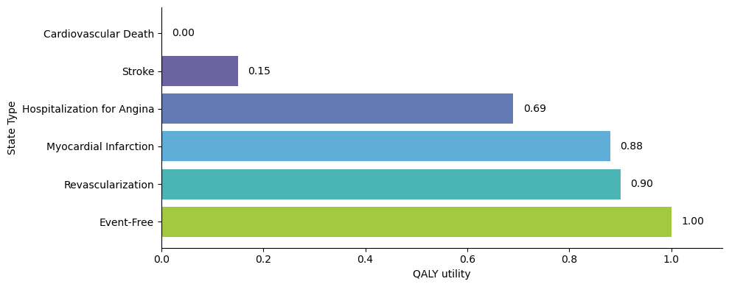
Quality Adjusted Life Year (QALY)
QALY : How long? & How well?
Motivation
Data Simulation
Methods
Result
Discussion
Notes:
So QALY is a concept in health economics, which combines two dimensions of measurement: How long people live and how well people feel about their life in one go. QALY utility is 1 means the perfect health state, 0 means death. Give you the example for our case, from the top to bottom is the from the worst to the best, and for each type of event they have their own utility values, for example, here utility of stroke is 0.15, which means if you live with stroke for a year then we regard you live only 0.15 quality year.

Slide 24
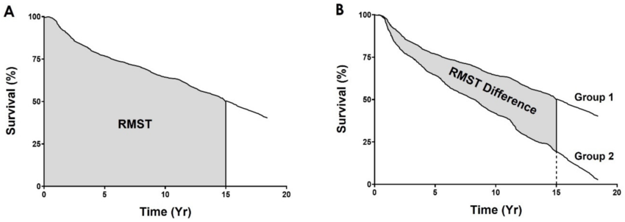
Restricted Mean Survival Time (RMST)
Motivation
Data Simulation
Methods
Result
Discussion
Notes:
And RMST is the area under the survival curve; it represents the average survival time up to a pre-defined time window. It is a more intuitive measurement and also does not require the proportional hazard assumption. And the RMST difference is the area between the two treatment groups, and it is a straightforward estimation of the treatment effect.

Slide 25

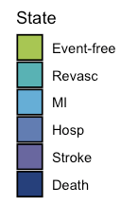
Q-RMST Method: No Censoring
Mr. Green
TIME(Month):
9
20
36
9
11
16
Event-free
Stroke
Revascularization
Motivation
Data Simulation
Methods
Result
Discussion
Notes:
Now it is the perfect time to introduce how we combined the Q with the RMST. We set up two scenarios: no censoring and censoring. Let’s start with the easy scenario, no censoring. So here is Mr. Green, he entered the trial with a state of event-free, and then after 9 months he experienced his first event stroke, and again after 11 months he experienced across second event revascularization, so during the entire follow-up time, 36 months, he experienced 2 events, and stayed in 3 different health states.

Slide 26
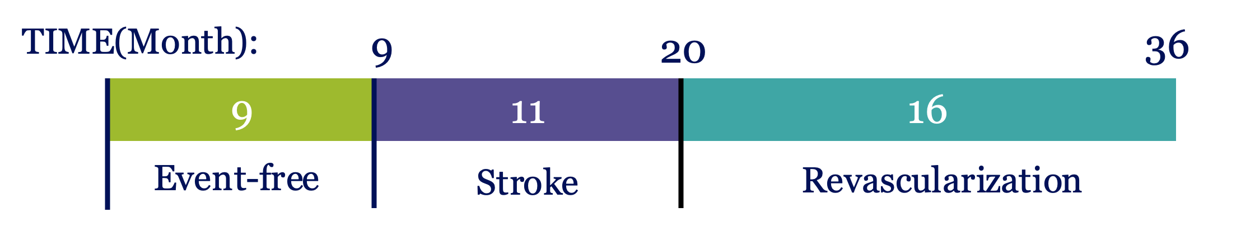
QALY Weight Accumulation
Markov Principle
The Worst Update Principle
Cumulative Product Principle
Conventional RMST
Motivation
Data Simulation
Methods
Result
Discussion
Notes:
To integrate QALY utilities to RMST, we need to consider how QALY utilities could be accumulated over time, so first we thought about a basic one, the Markov principle, where QALY weight depends only on the current state, not related to the past or future ones. And the second principle we named the worst update, where the weight reflects the lowest utility, a patient has reached up to that time; The third principle is cumulative product, which takes the product of all the events happened before. And the fourth one, we leave QALY out, make it a principle which actually is doing the conventional RMST, the area under the survival curve.

Slide 27
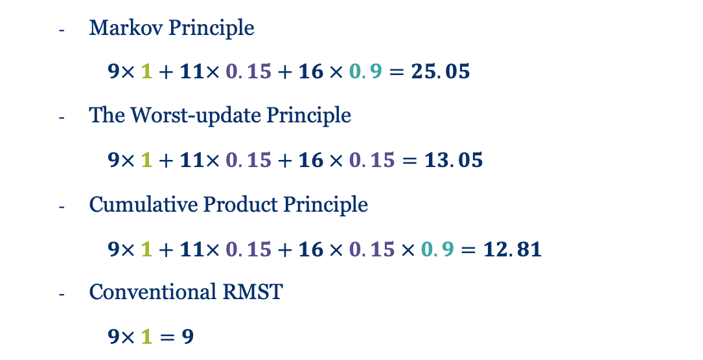
QALY Weight Accumulation
Markov Principle
$9× 1+11× 0.15+16 × 0.9=25.05$
The Worst-update Principle
$9× 1+11× 0.15+16 × 0.15=13.05$
Cumulative Product Principle
$9× 1+11× 0.15+16 × 0.15 × 0.9=12.81$
Conventional RMST
$9× 1=9$
Motivation
Data Simulation
Methods
Result
Discussion
Notes:
So now we are done with that many definitions, let’s check out how many Quality survival years Mr. Green has under 4 different principles. Here are the results: under the Markov principle, he lives quite long in terms of QALYs, but conventional RMST took a lot from him, because this rule didn’t give any attention to his actual health state; once he had one event, then Mr Green was gone.

Slide 28
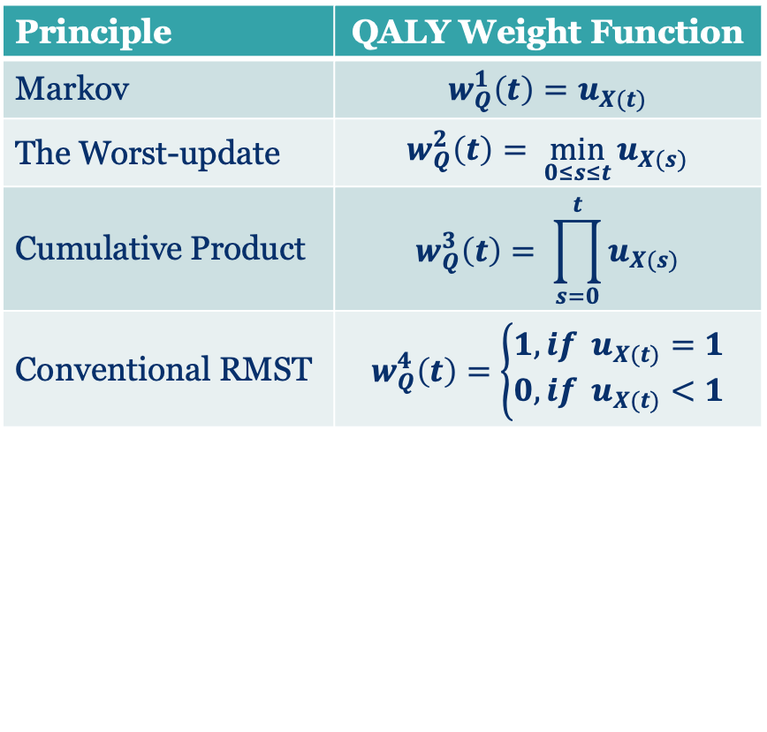
QALY Accumulated Weight Function
Markov Principle
$9× 1+11× 0.15+16 × 0.9=25.05$
The Worst-update Principle
$9× 1+11× 0.15+16 × 0.15=13.05$
Cumulative Product Principle
$9× 1+11× 0.15+16 × 0.15 × 0.9=12.81$
Conventional RMST
$9× 1=9$
Principle | QALY Weight Function
Markov | $$w_{Q}^{1}\left(t\right)=u_{X(t)}$$
The Worst-update | $$w_{Q}^{2}\left(t\right)= \min_{0≤s≤t}{u_{X(s)}}$$
Cumulative Product | $$w_{Q}^{3}\left(t\right)= \prod_{s=0}^{t}{u_{X(s)}}$$
Conventional RMST | $$w_{Q}^{4}\left(t\right)=\left\{\begin{aligned}1, if u_{X(t)}=1 \\ 0, if u_{X(t)}<1\end{aligned}\right.$$
Motivation
Data Simulation
Methods
Result
Discussion
Notes:
We generalized the QALY weight function from the calculation steps for each of the principles, and we will use these functions later.

Slide 29
Revascula-rization²
Angina⁴
Event-Free¹
MI³
Stroke⁵
Cv Death⁶
<- absorbing state
Q-RMST Method: Censoring
Revasculari-zation²
Angina⁴
Event-Free¹
MI³
Stroke⁵
Cv Death⁶
absorbing state
Motivation
Data Simulation
Methods
Result
Discussion
Notes:
The previous example of Mr. Green is a no-censoring scenario, and in the real trial data, we do have censoring. So we adopted a multi-state model into the Q-RMST method. And here is the demonstration of six states and all possible transitions among those states.

Slide 30
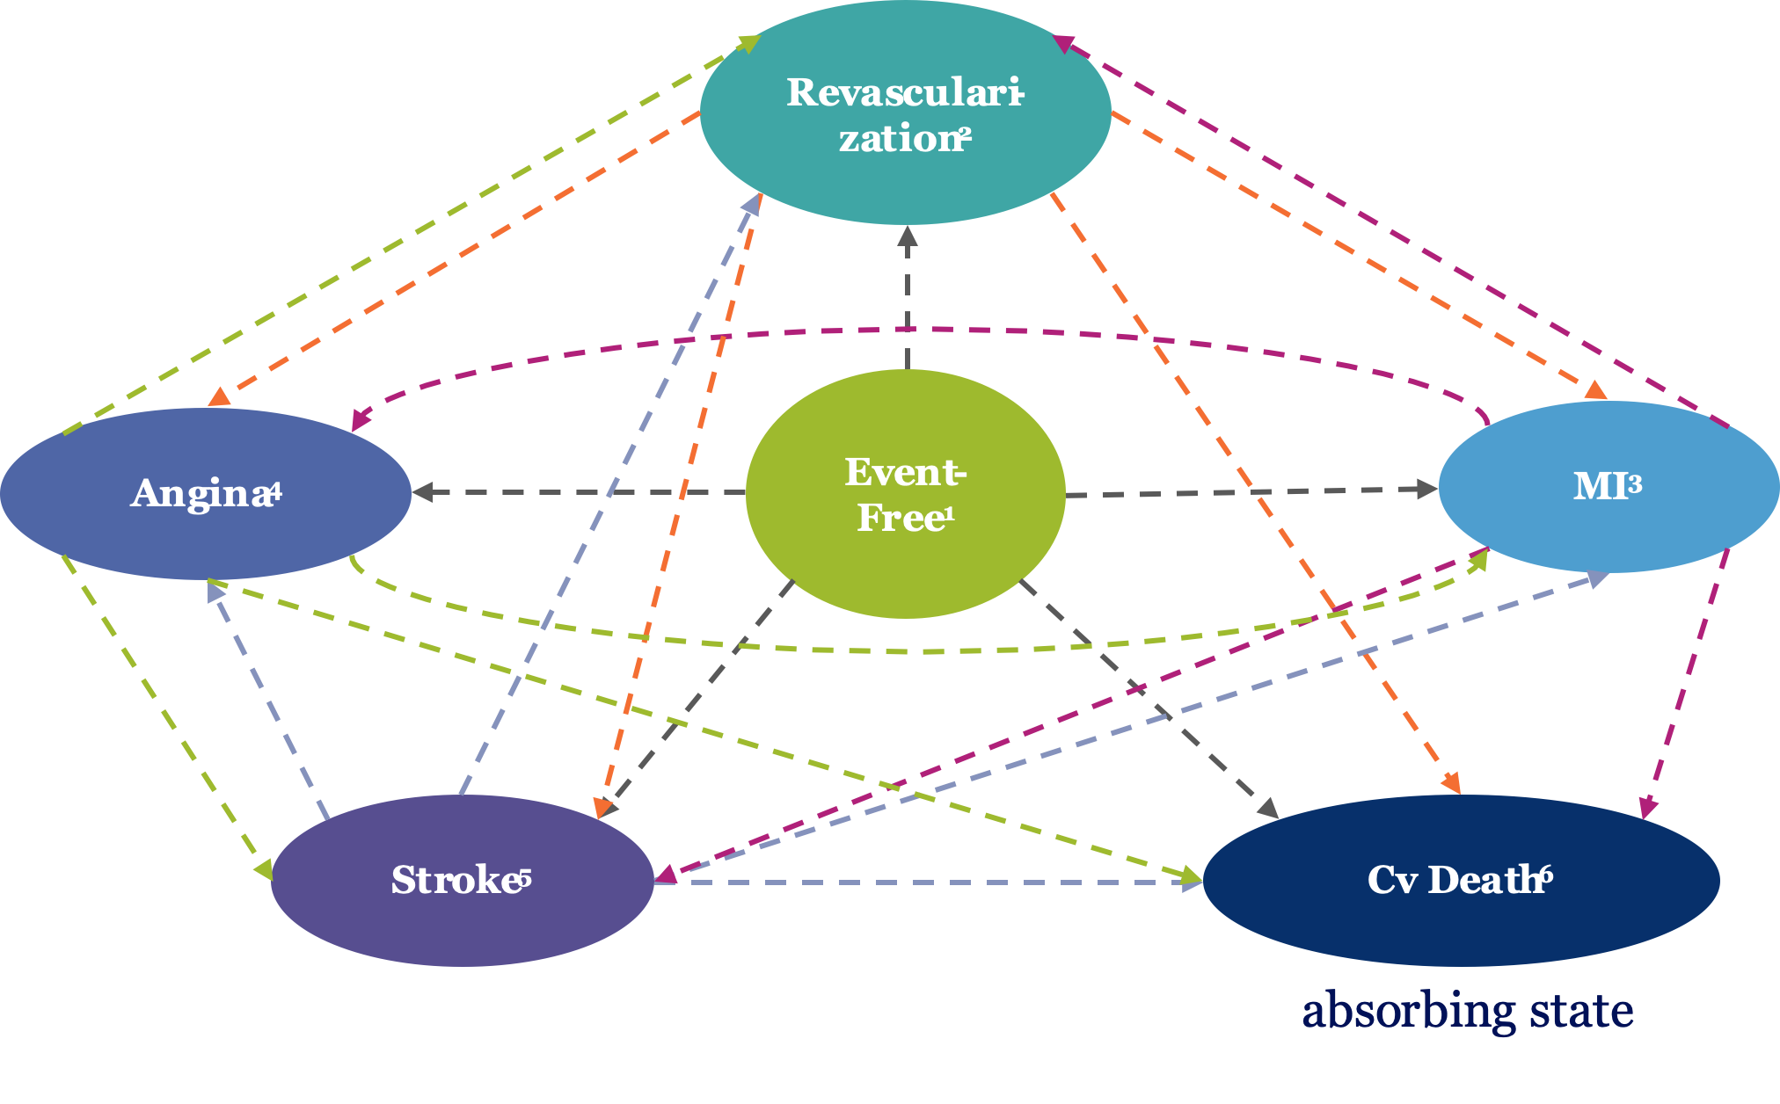
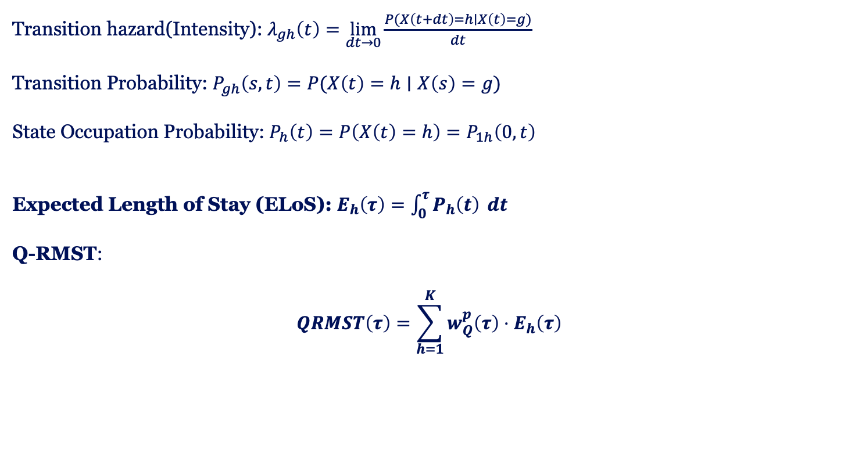
Q-RMST: Multi-state Model
Transition hazard(Intensity): $λ_{gh}\left(t\right)=\lim_{dt→0}{\frac{P(X\left(t+dt\right)=h∣X\left(t\right)=g)}{dt}}$
Transition Probability: $P_{gh}\left(s,t\right)=P(X\left(t\right)=h∣X\left(s\right)=g)$
State Occupation Probability: $P_{h}\left(t\right)=P\left(X\left(t\right)=h\right)=P_{1h}\left(0,t\right)$
Expected Length of Stay (ELoS): $E_{h}\left(τ\right)=\int_{0}^{τ}{P_{h}\left(t\right)} dt$
Q-RMST:
$$QRMST\left(τ\right)=\sum_{h=1}^{K}{w_{Q}^{p}\left(τ\right)⋅E_{h}\left(τ\right) }$$
Motivation
Data Simulation
Methods
Result
Discussion
Notes:
On the top left, you see some background knowledge about the multi-state model: transition hazard, transition probability, and state occupation probability. There are many theories behind it, which we won’t go into now. What matters here is the equation for the expected length of stay — the integral of the state occupation probability from time zero to tau. When we multiply this by the QALY weighting function we introduced earlier, we arrive at the formula for Q-RMST. We made it!

Slide 31
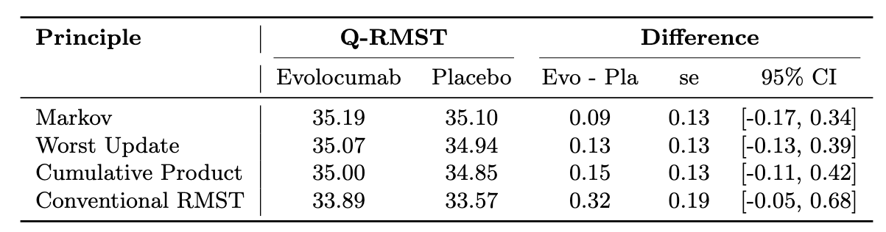
Result: Q-RMST (in months)
Motivation
Data Simulation
Methods
Result
Discussion
Notes:
Now let’s look at the Q-RMST results for the FOURIER Trial. In the green box, you can see the differences between the two groups under the four principles. For the first three principles, the differences are all under five quality days, and for conventional RMST, it’s under ten days. Looking at the confidence intervals, zero is included in all of them, which means there’s no significant difference between the groups.

Slide 32
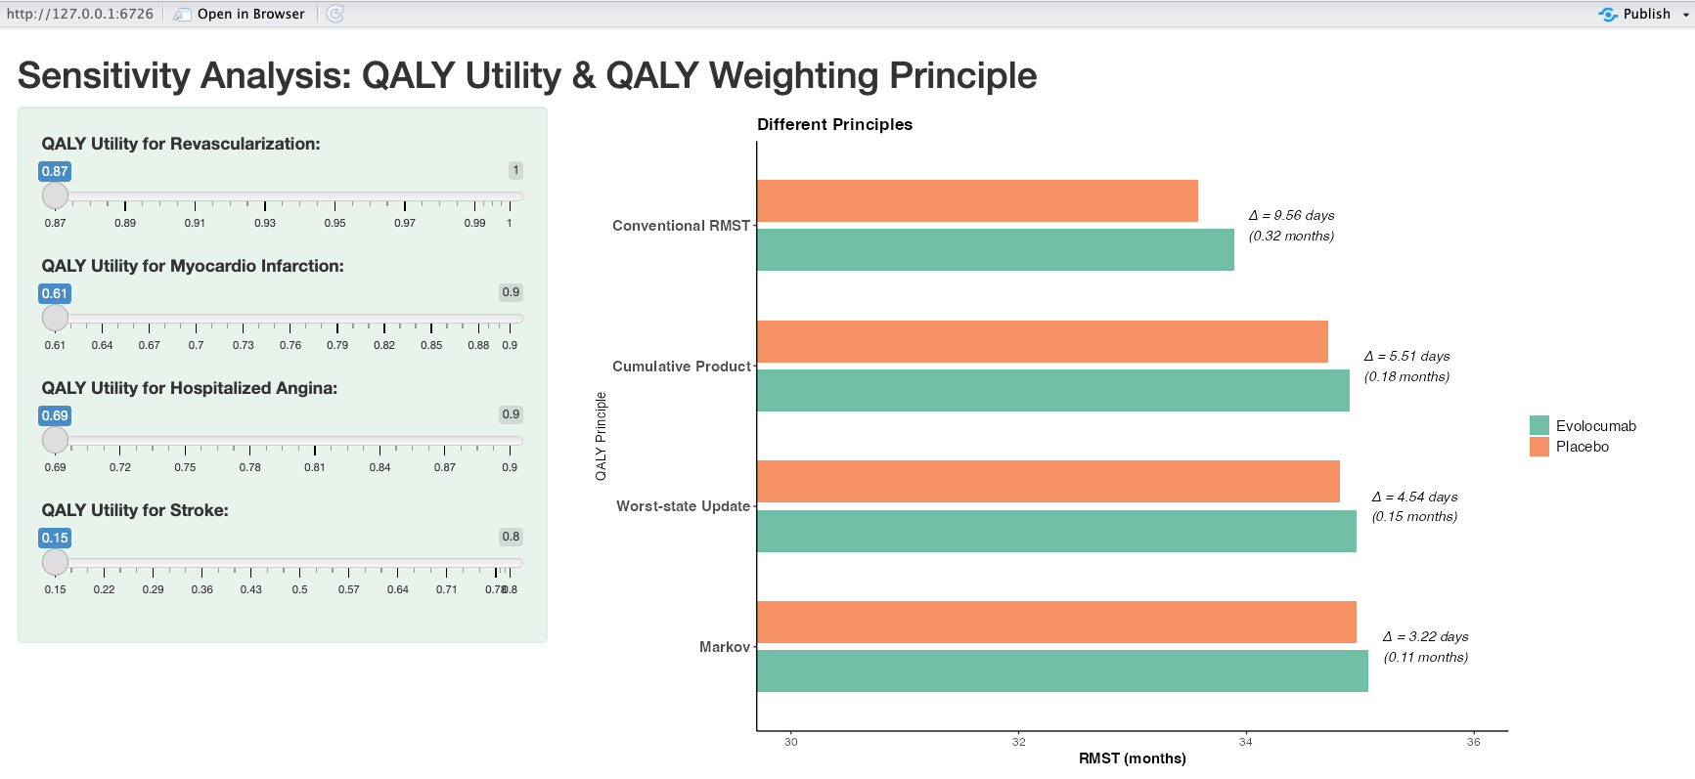
Sensitivity Analysis: Shiny App
Max.
5.51 days
Motivation
Data Simulation
Methods
Result
Discussion
Notes:
To do the sensitivity analysis, I wrote a Shiny application to visualize the dynamic change. It is a user-interactive surface, where you can adjust the QALY utility values in the left side bar, and then the bar plots will change accordingly. I found the maximum difference between the two groups is 5.5 Quality days.

Slide 33
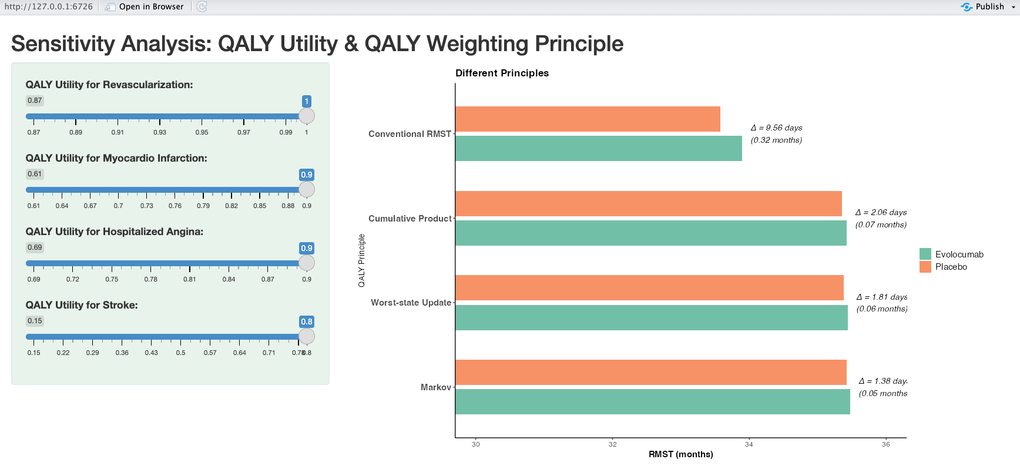
Sensitivity Analysis: Shiny App
Min.
1.36 days
Motivation
Data Simulation
Methods
Result
Discussion
Notes:
And the minimum difference is 1.4 days. This actually supports our conclusion, furthermore, that there is no significant difference between the two groups.

Slide 34
Discussion
Trial Data
Constant hazard assumption -> Weibull distribution
Q-RMST
Constant QALY utility in the same state -> vary over time
Result
Based on simulated data and should not be interpreted as a definitive conclusion
Shiny app is a starting point bridge method to end users
Motivation
Data Simulation
Methods
Result
Discussion
Notes:
Now, let’s discuss our work. For the trial data, we assumed constant hazards in the simulation, which works well here, but it could be extended to a Weibull distribution for broader use. For Q-RMST, we assumed constant QALY utilities within the same state, though in reality they could vary over time. And, our results are based on simulated data, so they’re not a definitive conclusion — the main goal was to show how Q-RMST works. And I am very happy with the sensitivity analysis tool, which I think is a starting point to bridge methodology with real-world practice. It provides an interactive surface to the end user, mostly clinicians, where they can input their own opinion about the QALY utility and see the results under the most suitable principle.

Slide 35
Questions?
Notes:
Thank you for your time. That’s the end of my presentation, and I look forward to your questions!

Slide 36
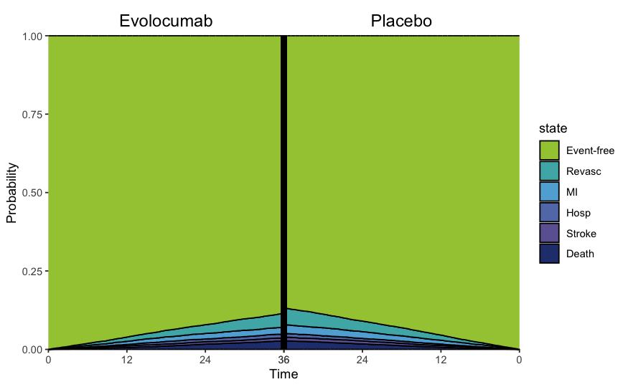
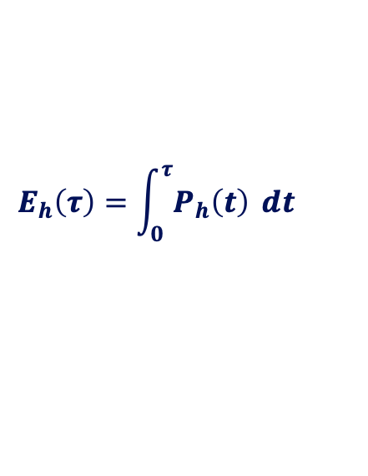
Result: Expected Length of Stay (ELoS)
$$E_{h}\left(τ\right)=\int_{0}^{τ}{P_{h}\left(t\right)} dt$$
Markov Principle

Slide 37
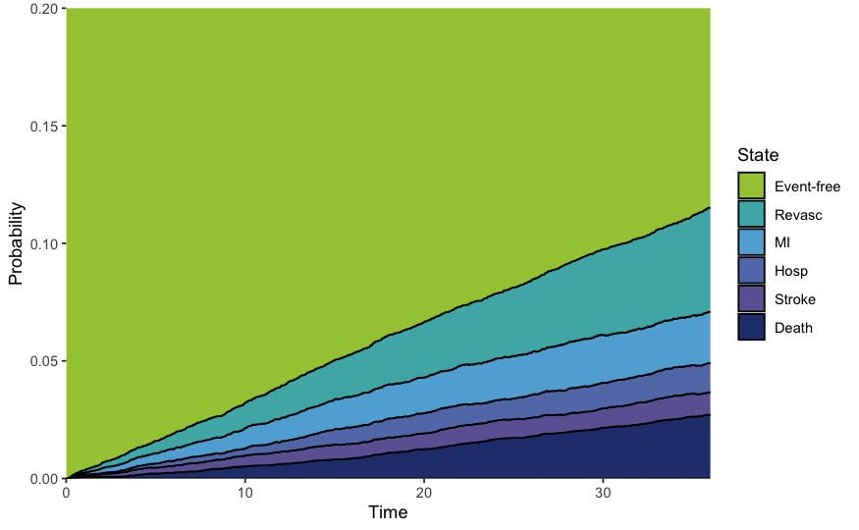
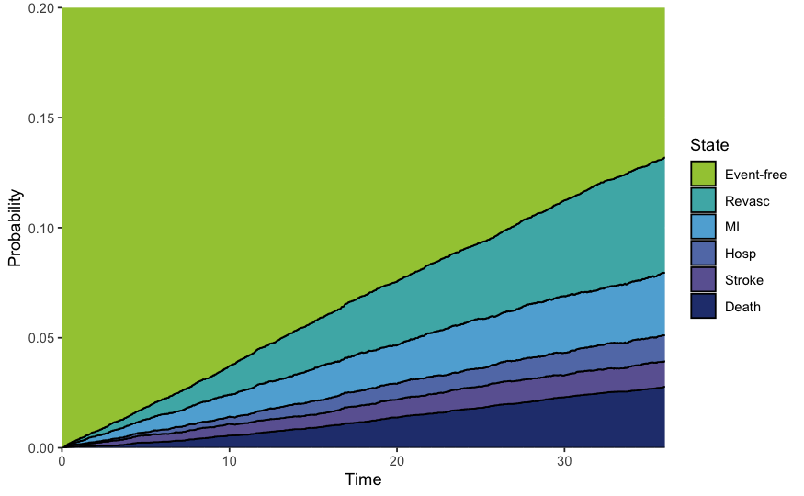
Result: Expected Length of Stay (ELoS)
$$E_{h}\left(τ\right)=\int_{0}^{τ}{P_{h}\left(t\right)} dt$$
Markov Principle
🔍
0.20

Slide 38
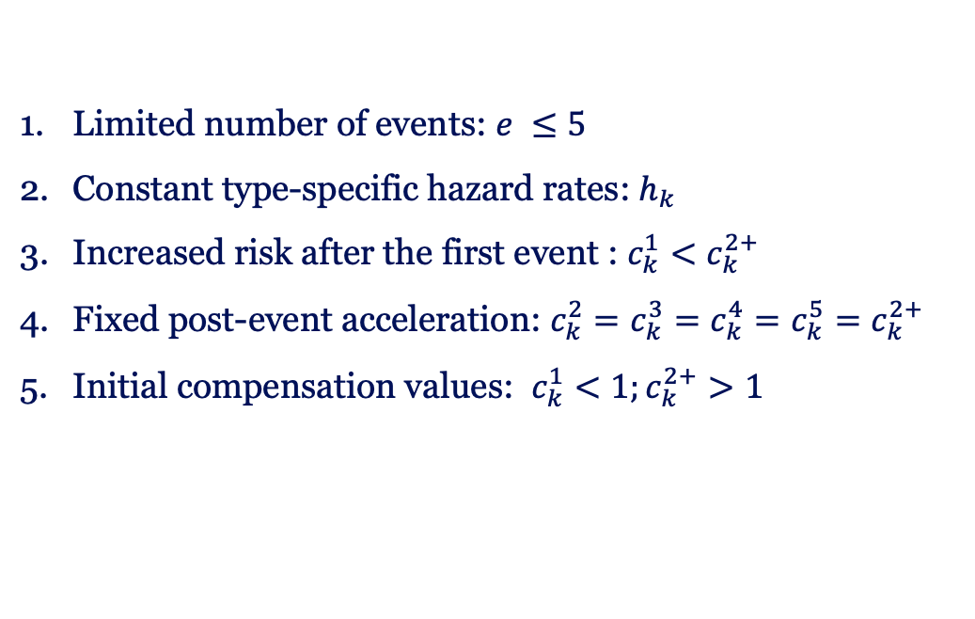
Type 1
Type 1
Type 1
Type 1
Type 1
Type 2
Type 2
Type 2
Type 2
Type 2
Event Free
Type 3
Type 3
Type 3
Type 3
Type 3
Type 4
Type 4
Type 4
Type 4
Type 4
Type 5
Type 5
Type 5
Type 5
Type 5
Assumptions for Reverse Engineering
Limited number of events: $e ≤5$
Constant type-specific hazard rates: $h_{k}$
Increased risk after the first event : $c_{k}^{1}<c_{k}^{2+}$
Fixed post-event acceleration: $c_{k}^{2}=c_{k}^{3}=c_{k}^{4}=c_{k}^{5}=c_{k}^{2+}$
Initial compensation values: $c_{k}^{1}<1;c_{k}^{2+}>1$

Slide 39
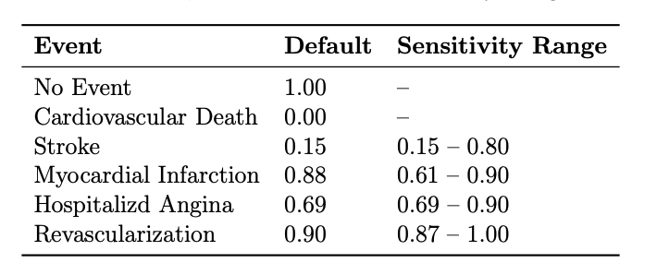
Sensitivity Analysis: QALY utilities

Slide 40
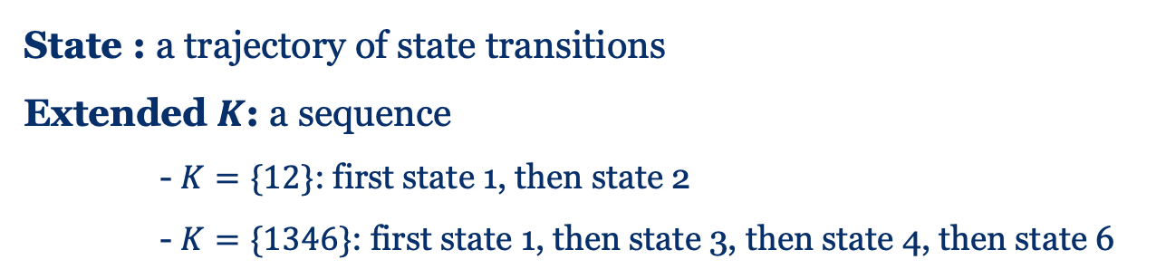
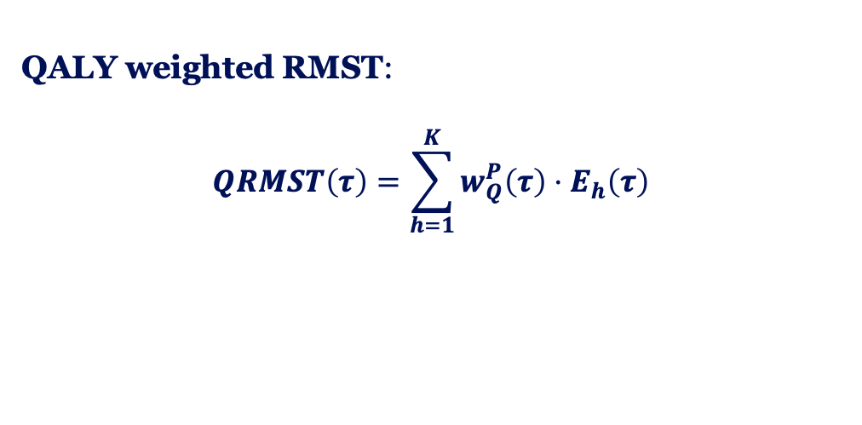
Q-RMST: Extended Multi-state Model
...
...
3
QALY weighted RMST:
$$QRMST\left(τ\right)=\sum_{h=1}^{K}{w_{Q}^{P}\left(τ\right)⋅E_{h}\left(τ\right) }$$
4
2
...
5
2
2
4
6
3
...
2
5
3
4
2
6
1
4
3
...
6
...
6
State : a trajectory of state transitions
Extended $K$: a sequence
- $K=\{12\}$: first state 1, then state 2
- $K=\{1346\}$: first state 1, then state 3, then state 4, then state 6
5
5
6
6
2
...
...
...
6

Slide 41
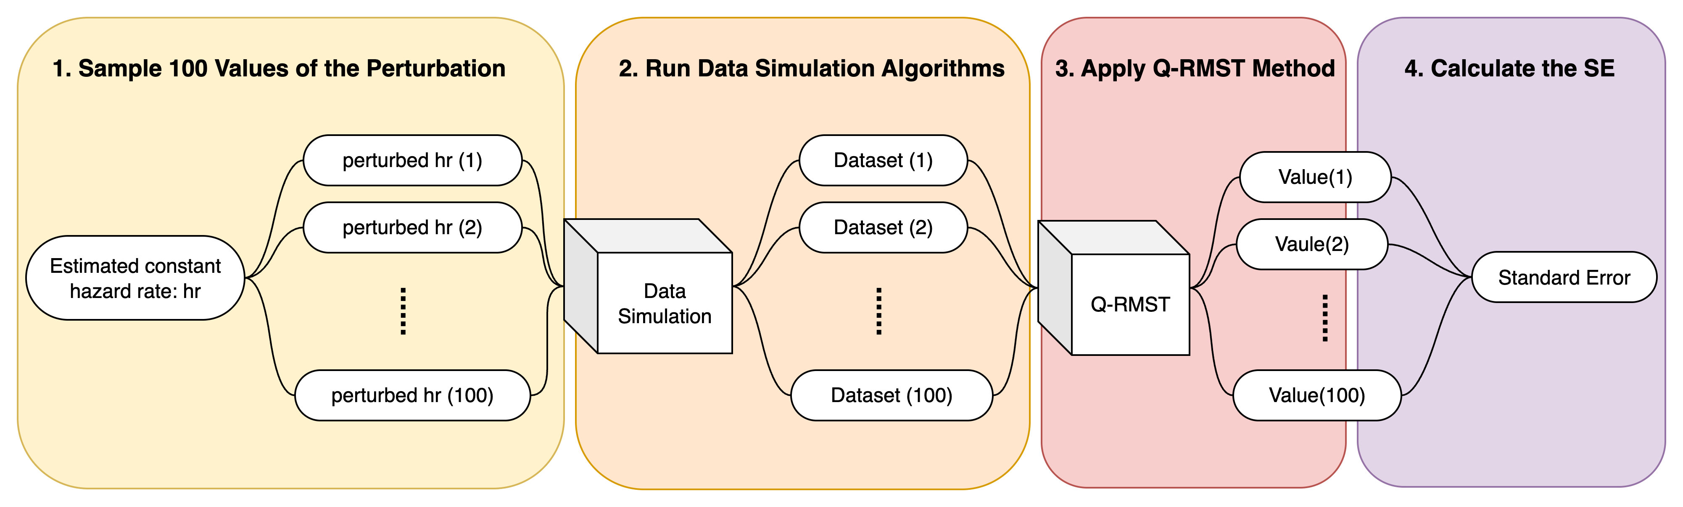
Q-RMST: Uncertainty Analysis

